Slide 1
VETERINARY PARASITOLOGY
THIRD YEAR STAGE
2018-2019
PROF. DR. GAHZI Y. AL-EMARAH
PARASITOLOGEST
Department of Veterinary Microbiology and Parasitology
College of Veterinary Medicine
University of Basrah

Slide 2
NEMATODA
FAMILY: HETERAKIDEA
General Characteristics
- Medium sized to small worms.
- It having three lips around the mouth.
- A small buccal cavity and pharynx.
- Lateral alae extending down the body.
- Oesophagus in three parts (a short pharynx , a cylindrical,middle par and bulbous posterior part ).
- A pre-anal sucker at the tail end of male which has a chitinous rim ,with many anal papillae.

Slide 3
NEMATODA
Hetrakis gallinarum
General Characteristics
- Occurs in the caeca.
- The host :fowl, guinea fowl turkey, goose and various wild birds in most parts of the world.
- The males are 7-13mm long and the females 10-15mm.
- It having three large lips .
- The male tail is provided with large alae.
- Per-cloacal sucker and twelve pairs of papillae.

Slide 4
NEMATODA
Hetrakis gallinarum
General Characteristics
- There are large lateral alae extending some distance down
the side of the body .
- The oesophagus has a strong posterior bulb.
- The spicules are unequal, the right being slender and 2mm long,while the left has broad alae and measure about 0.65-0.7mm long.
- The vulva opens directly behind the middle of the body.

Slide 5
NEMATODA
Hetrakis gallinarum
General Characteristics
- The eggs have thick ,smooth shell ,they measure 65-80×35-
46Mm and are un segmented when laid.
Life Cycle
- The female lay eggs.
- The eggs in the feces of the host
- Develop to the infective stage(second stage larva in egg)in the open in 14 days or longer depending on the temperature.

Slide 6
NEMATODA
Hetrakis gallinarum
Life Cycle
- The eggs are very resistant to adverse condition , and may remain viable soil for months. But dry ,hot weather killed -The infection takes place through ingestion of the eggs with food or water sucking.
- The ingested eggs hatch in the intestine after 1 or 2 hours .
- Second stage larvae spend two to five days in the glandular epithelium before continuing their development in the lumen.

Slide 7
NEMATODA
Hetrakis gallinarum
Life Cycle
- They molt to the third stage on the sixth day after infection ,L4 on the tenth day and L5 on the fifteenth day .
- The prepatent period is 24- 30 day.

Slide 8
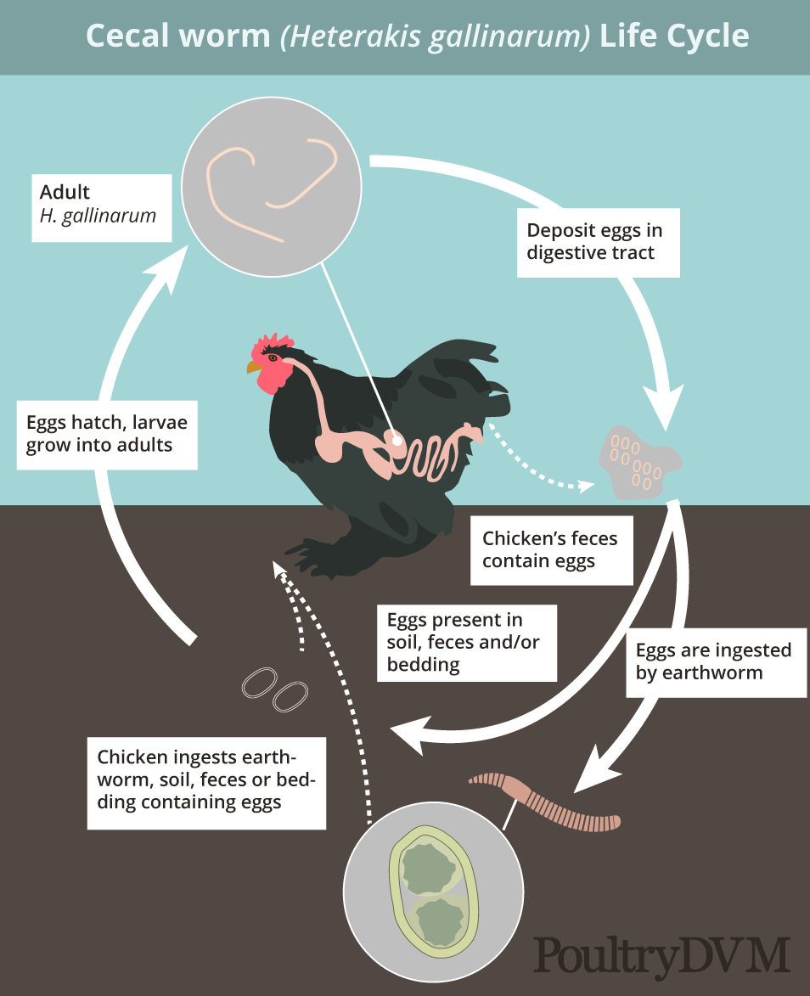
NEMATODA
Life Cycle of Heterakis gallinarum

Slide 9
NEMATODA
Hetrakis gallinarum
Pathogenicity and Pathogenesis
The heavy infection may there be thickening of the caecal mucosa
1- Nodular typhlitis.
2- Number of petechial haemorrhages on the surface of intestine.
3- Pnemonia.

Slide 10
NEMATODA
Hetrakis gallinarum
Clinical Signs
1- Diarrhoea.
2- Wasting.
3- Markedly emaciated.
Diagnosis and Treatment
- Clinical signs.
- Faecal exam.
- Serological exam.

Slide 11
NEMATODA
Hetrakis gallinarum
Treatment
Treatment with: Rx, salt of piprazine (dihydrochloride and citrate ) and Albendazoal.

Slide 12
NEMATODA
FAMILY: SUBULURIDEA
Subulura brampti
General Characteristics
- Occurs in the caeca.
- The host :fowl, guinea fowl ,turkey and wild related birds in Africa ,north and south America and Asia .
- The males are 6.9-10mm long and the females 9-17.5mm.
- It having the small buccal capsule has three teeth at its base .

Slide 13
NEMATODA
FAMILY: SUBULURIDEA
Subulura brampti
General Characteristics
- The male tail is provided with large lateral alae and is curved ventral.
- The per-cloacal sucker is an elongate slit, surrounded by radiating muscle fibers.
- There are lateral alae .
- The vulva is situated just anterior to the middle of the body.

Slide 14
NEMATODA
FAMILY: SUBULURIDEA
Subulura brampti
General Characteristics
- The oesophagus has a small swelling posteriorly ,followed by a deep constriction and then a spherical bulb.
- There are ten pairs of small caudal papillae .
- The vulva is situated just anterior to the middle of the body.
- The spicules are equal 1.3-1.5mm long.

Slide 15
NEMATODA
FAMILY: SUBULURIDEA
Subulura brampti
General Characteristics
- The eggs have thick ,smooth shell ,they measure 52-64by 41- 49Mm and are fully developed embryo when laid.
Life cycle
The intermediate hosts are various beetle of the Blaps and the cockroach Blatella germanica.

Slide 16
THANK YOU

